Slide 1
Hacksummit 2.0
Topic- Disaster Management System
Group Members:-
Tiyasha Samanta (Team Leader)
Soumya Mohanty
Soumyoneel Dey
Nisarg Doshi
Group name- Fab_4Z

Slide 2
Objective
Basically the main goal of disaster management is to reduce the damages and to safeguard common people including physically challenged people during the natural calamities. So here we are trying to create a Portal with the following objectives :-
Reducing vulnerability and potential losses of hazard by alerting the necessary info of the upcoming disaster.
Assessing, reviewing and controlling the risk. Applying efficient, effective, sustainable relief (food, shelter and money), medical and other facilities in disaster affected people thus they can survive.
Reducing the damage, death, sufferings and destruction of any natural and human induced disaster.
Ensuring the availability of local emergency equipment and transportation through NGO's and government helpline numbers.
NGOs organizations can join these website so that the donated money can be given to the people who are in need.

Slide 3
Implementation
FRONTEND:- Html , Css , Javascript, Bootstrap
BACKEND:- Nodemon , Node.js
DATABASE:- MySQL
The portal will have a live button feature which will give real-time weather condition for your given location. It will able to predict whether any cyclone or any other natural calamity will affect your location or not .
This Portal will additionally have a voice assistant feature to help physically handicapped people to surf our website easily.

Slide 4
Application
Prediction about natural calamity
Aware people about such calamity so they are less affected
Help the affected people by providing food, shelter, clothes etc.
Rescue people who are in need.
Future prospect will be to ask some NGOs organization to join our website so that they we can donate money to the people who are in need.

Slide 5
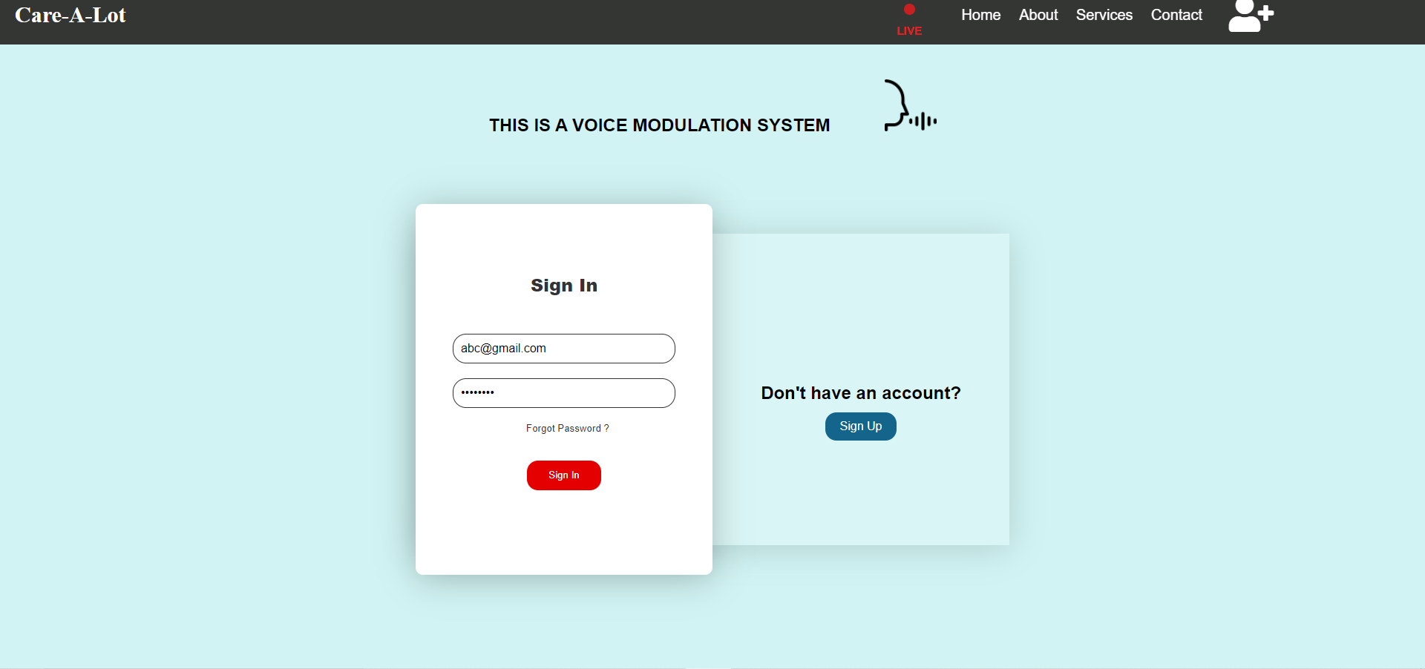
Sign In Page

Slide 6
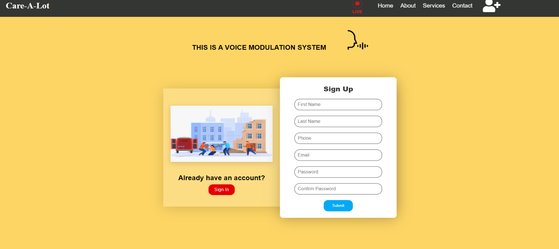
Sign Up Page

Slide 7
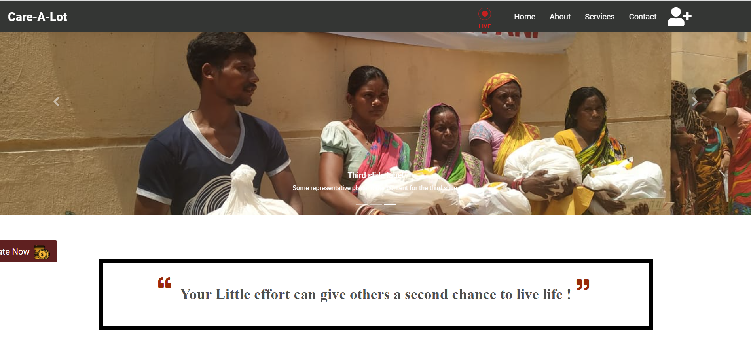
Home Page

Slide 8
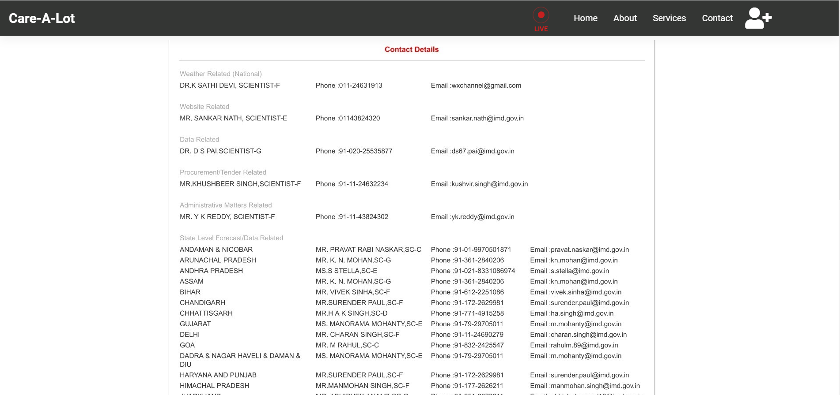
Contact Page

Slide 9
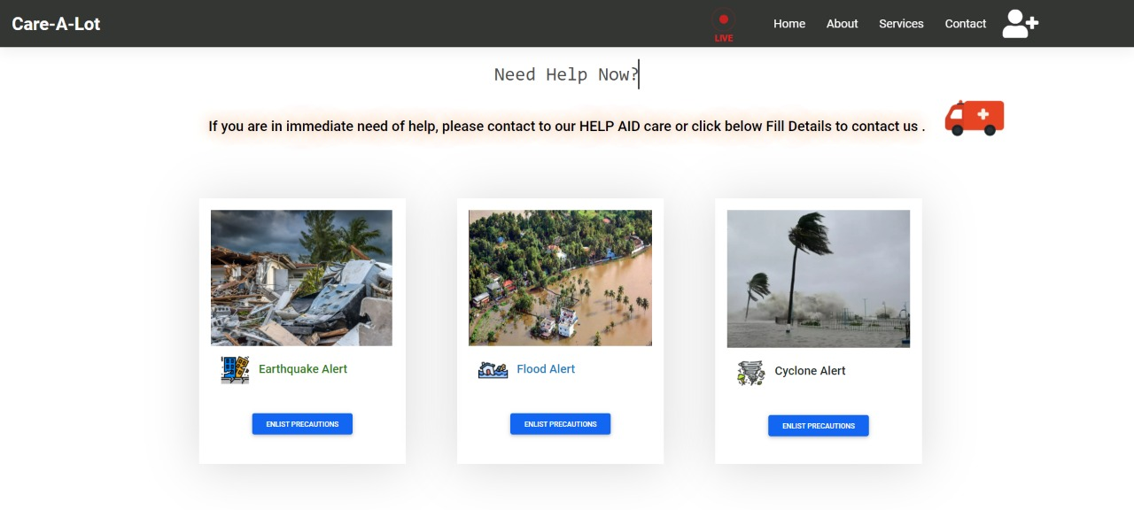
Service Page

Slide 10
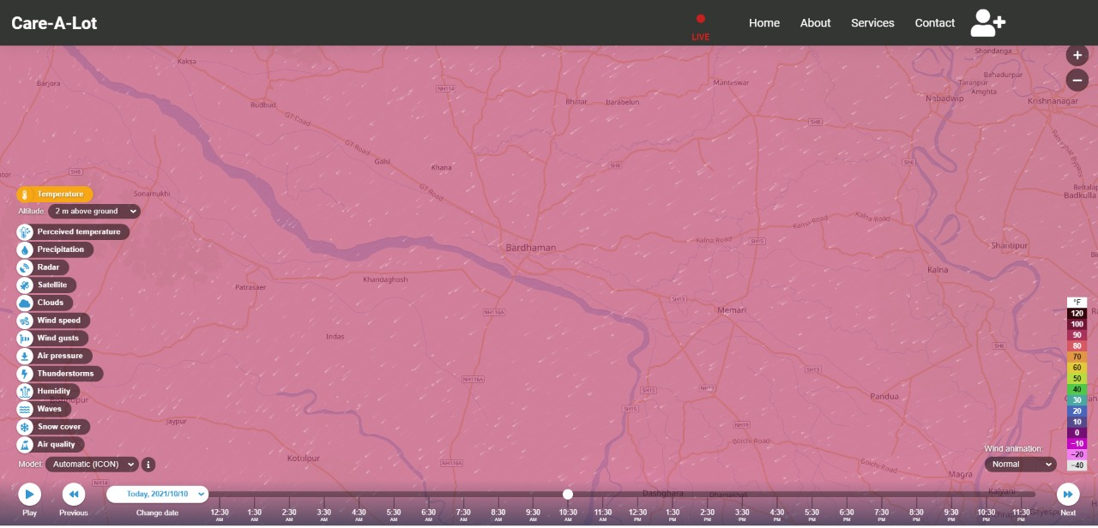
Live Page

Slide 11
Conclusion
A disaster management software will basically help the people in getting aware about any type of natural calamity. They will be able to take precautions in the early stage of the calamity. Also the website will be able to track the location of the affected people who are in need of help. The website will also contain phone numbers about nearby rescue operation team, who can help in case of any emergency. These will basically help in saving human lifes and reduce the suffering.

